Slide 1

Heart Attack Risk Prediction

Slide 2
About me
Background ? (B-tech)
I have graduated with a B-Tech degree in Electrical and Electronics Engineering in 2024.
Why you want to learn Data Science
As a 2024 B-Tech graduate, I want to learn data science because of my passion for analyzing data to uncover meaningful insights that can drive impactful decisions.
Additionally, data science offers extensive opportunities for growth and impact, making it an ideal field for me to start my career as a fresher.
Any work experience
I do not have any prior work experience.
Share your linkedin and github profile urls
LinkedIn:- https://www.linkedin.com/in/rohith-kumar-99720b280
GitHub:- https://github.com/Rohithmasineni

Slide 3
Business Problem
The problem statement is focused on predicting the risk of heart attacks in individuals by analyzing various health and lifestyle-related factors collected from a structured dataset.
By examining features such as gender, smoking habits, alcohol consumption, previous heart attack history, blood pressure levels, diet scores, and more, the aim is solely to predict whether an individual is at risk of a heart attack or not using machine learning techniques.

Slide 4
Use Cases
1. Health Trend Analysis
Identify patterns and trends in heart attack risks across different age groups, genders, and geographical areas to better understand vulnerable populations.
2. Preventive Healthcare Actions
Support individuals and healthcare professionals in making informed, measurable decisions aimed at reducing heart attack risks through targeted lifestyle and medical interventions.
3. Policy and Infrastructure Planning
Assist healthcare departments and government bodies in identifying high-risk zones and populations, thereby enabling the effective allocation of health resources and infrastructure.
4. Future Technological Advancements
Lay the foundation for developing more advanced, real-time predictive systems that can save lives by enabling early detection and reducing diagnosis time through automation and AI-driven insights.

Slide 5
Objective of the Project
The objective of this project is to:
Collect and analyze individual health and lifestyle-related data to build a predictive system that predicts the likelihood of a heart attack occurrence.
The next step involves performing data cleaning and exploratory data analysis to handle missing values, remove duplicates, and uncover patterns among features such as age, gender, smoking habits, alcohol consumption, blood pressure, and diet scores.
Data Preprocessing & Modelling:
Relevant preprocessing techniques such as encoding categorical variables and scaling numerical features are applied to prepare the data for machine learning.
Classification algorithms are then trained and evaluated to build a model that predicts heart attack risk, with key insights visualized through graphs and metrics for interpretation.

Slide 6
Data Source:
The dataset used in this project is publicly available on Kaggle, a popular platform for data science and machine learning datasets.
Dataset Link :- Heart Attack Risk Prediction Dataset on Kaggle
This dataset provides detailed health-related information of individuals from various Indian states, capturing key demographic details, lifestyle habits, medical history, and access to healthcare.
It is specifically designed to support heart attack risk prediction and cardiovascular disease research within the Indian population, offering valuable insights into common risk factors.
Summary of the Data:
The dataset has 10,000 rows and 26 columns, which include information about people's health, lifestyle, and other factors that can affect the risk of a heart attack.
However, some columns in the dataset were not very important for training the model and could affect its performance. So, they were removed to keep the model focused, faster, and aligned with the project's main goals.

Slide 7
Initial Data Exploration & Cleaning Steps
Started by exploring the dataset to understand its structure, the types of data available, and the overall quality.
Reviewed each column to assess its relevance to the heart attack prediction use case, identifying which features were meaningful.
Identified a few columns that were not useful for model training and could negatively impact performance. These were dropped to keep the model efficient and focused.
Dropped Columns:
['Patient_ID', 'State_Name', 'LDL_Level', 'HDL_Level', 'Healthcare_Access', 'Annual_Income', 'Health_Insurance’]
Checked for missing values and duplicate entries to ensure the dataset was clean and ready for analysis.
Confirmed that the dataset had no null values or duplicates, making it suitable for the next step — Exploratory Data Analysis (EDA).

Slide 8
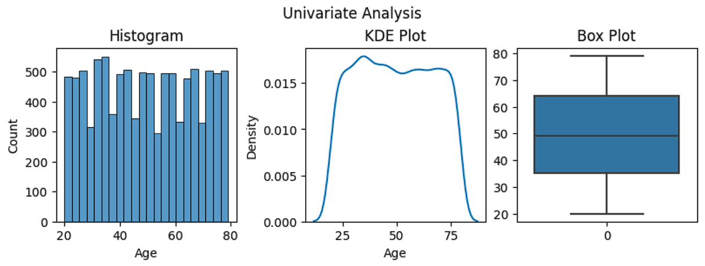
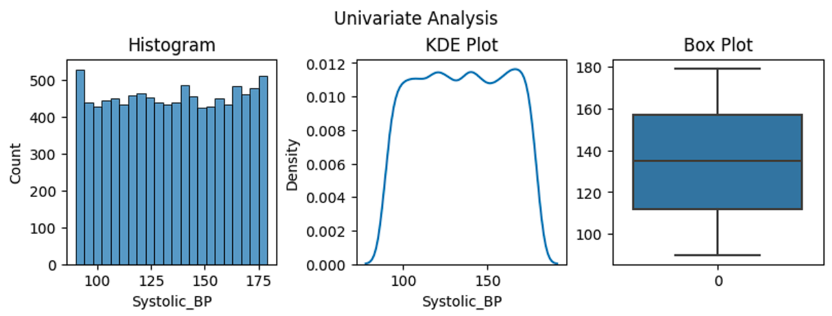
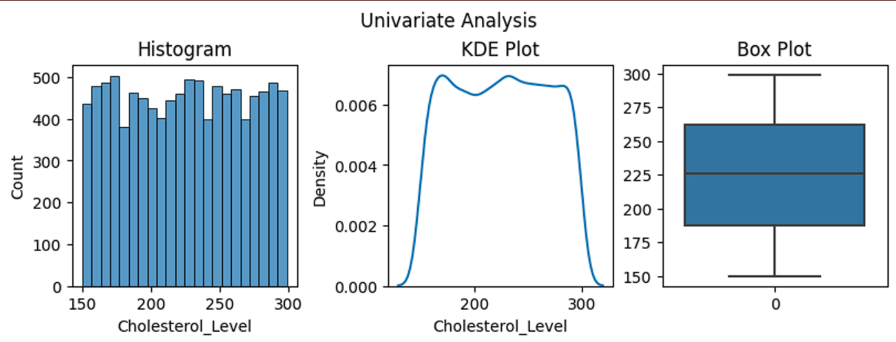
Exploratory Data Analysis
Univariate Analysis:

Slide 9
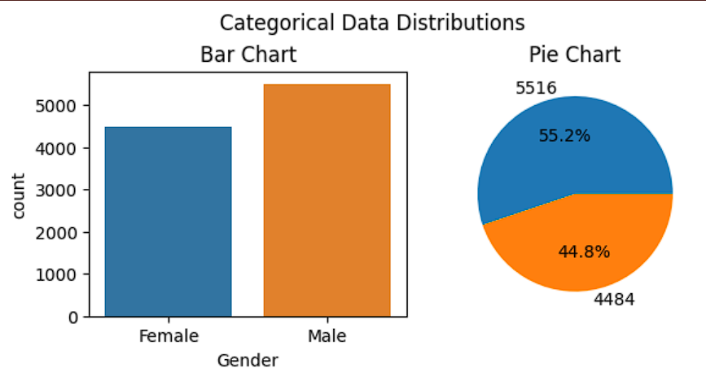
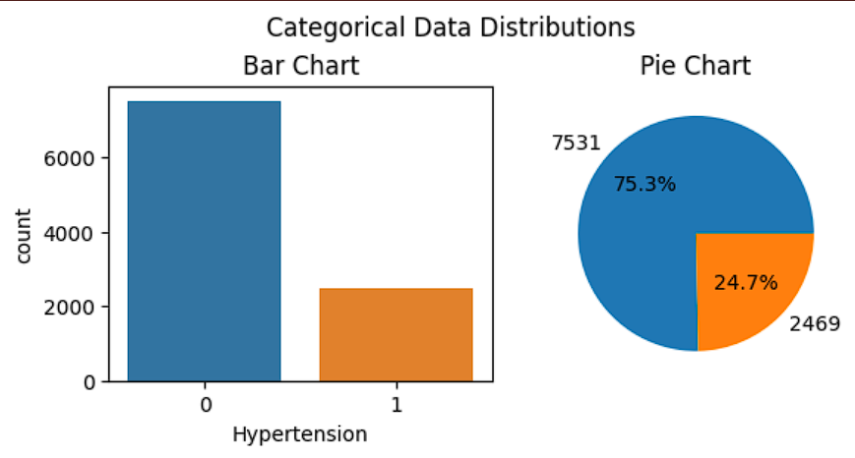
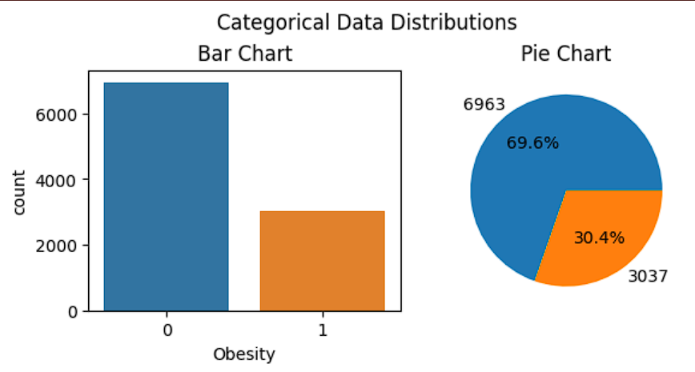
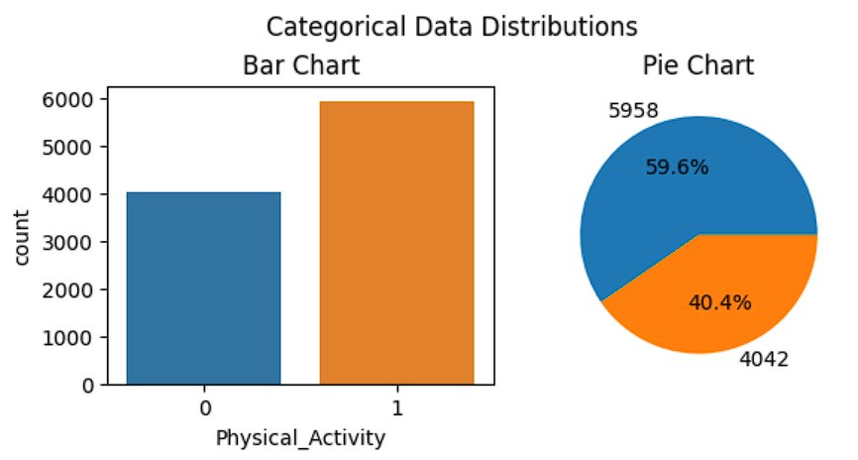
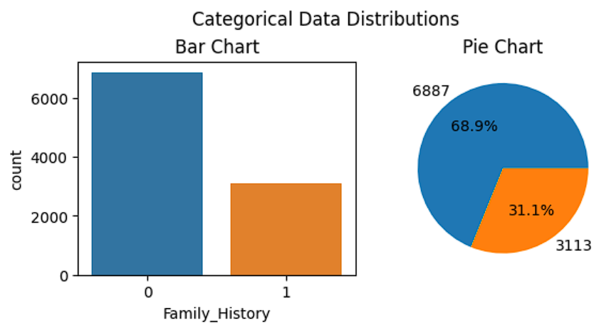
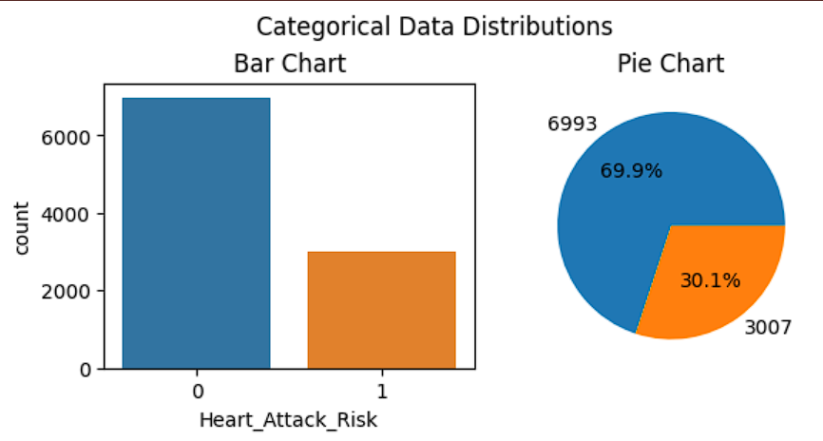
Exploratory Data Analysis
Univariate Analysis:

Slide 10
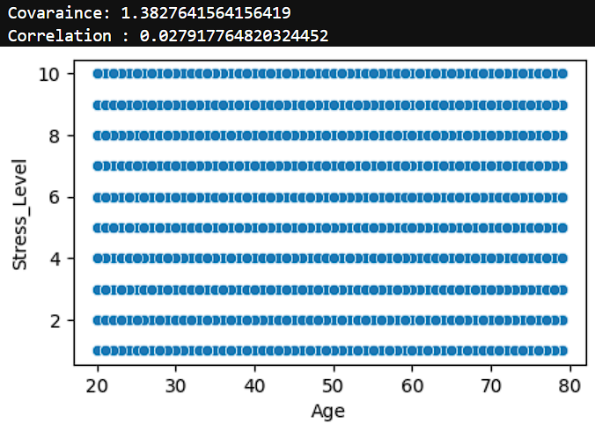
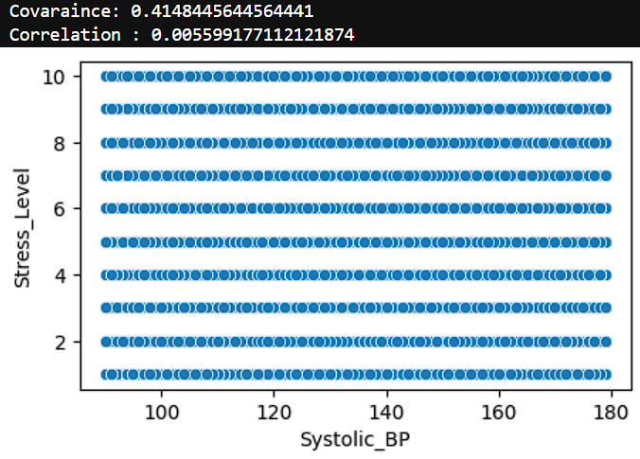
Bivariate Analysis
The data shows variation in stress levels across different age groups, but there is no clear trend linking age to stress level. Correlation: The correlation value is close to zero, suggesting that age does not strongly influence stress levels in the dataset. | The data shows no clear trend between Stress Level and Systolic BP, indicating little to no correlation. Correlation: The correlation value is near zero, suggesting that stress levels do not significantly impact systolic blood pressure.

Slide 11
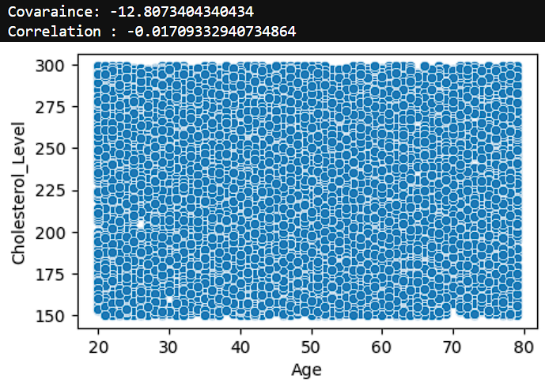
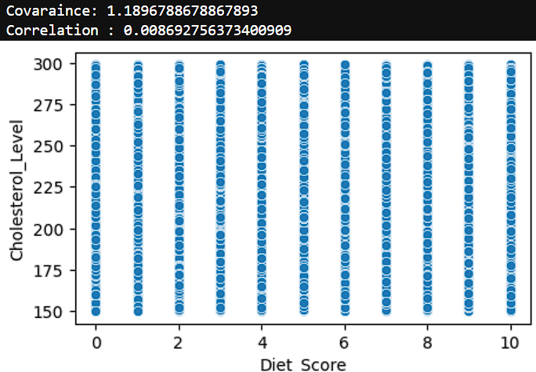
Bivariate Analysis
The data points show no clear trend between Cholesterol Level and Age, indicating little to no relationship between them. Correlation: The correlation value is close to zero, suggesting that age does not significantly impact cholesterol levels in this dataset. | The data shows no strong trend between Diet Score and Cholesterol Level, indicating a weak or no correlation. Correlation: The correlation value is close to zero, suggesting that diet quality does not significantly impact cholesterol levels in this dataset.

Slide 12
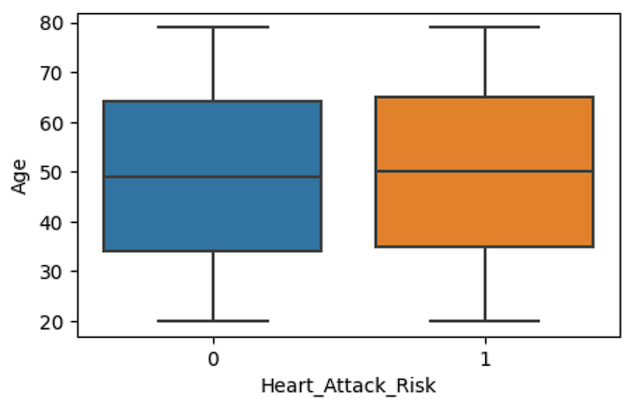
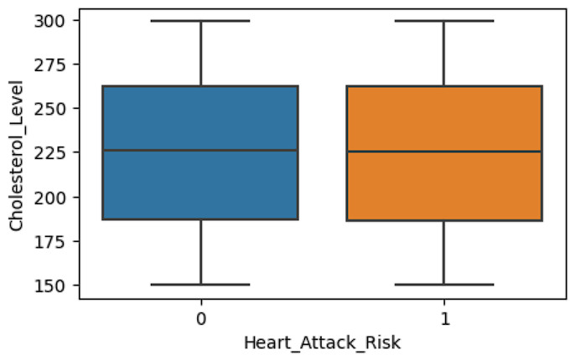
Bivariate Analysis
Age and Risk Spread: The median age in both groups is around 50, showing heart attack risk isn't confined to older individuals. Variability in Age Groups: The range is similar for both groups, indicating heart attacks can occur at various ages, influenced by other health factors. | Cholesterol Levels and Heart Risk: Both groups show a similar median cholesterol level, implying that heart attack risk isn't solely driven by cholesterol variations. Range of Cholesterol Values: The spread of cholesterol levels remains broad across both groups, indicating that other health factors likely play a role in heart attack risk.

Slide 13
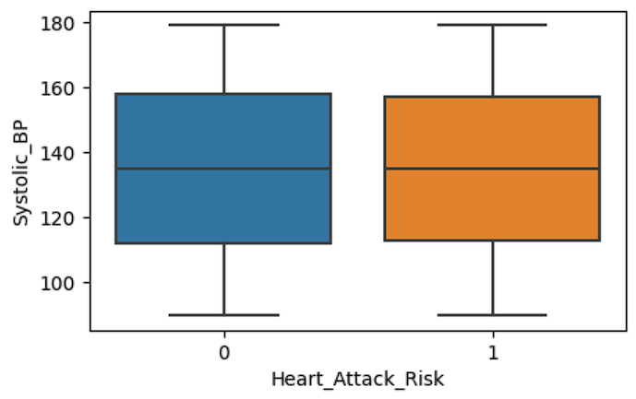
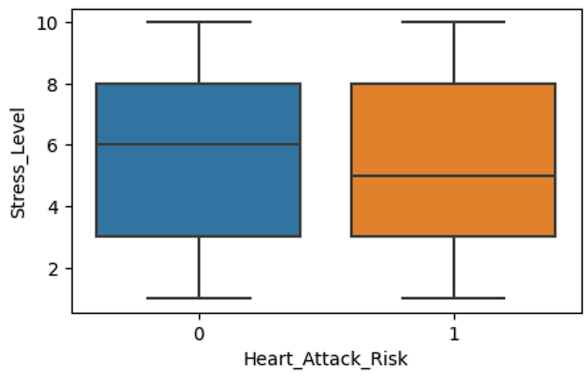
Bivariate Analysis
Blood Pressure Levels in Both Groups: The median blood pressure values remain close between individuals with and without heart attack risk, indicating no clear separation based on this feature. | People without heart attack risk (blue) generally have lower stress levels compared to those with risk, suggesting stress might be a contributing factor.

Slide 14
Data Preprocessing
Label Encoding:
Converted categorical values like “Gender” into numerical format (e.g., Male = 1, Female = 0). So that models can understand and process them.
Feature-Target Split:
Separated the dataset into input features “X” and target variable “y” (Heart_Attack_Risk) for model training.
Train-Test Split (Before Scaling):
Divided the data into training and testing sets before scaling to ensure the model does not get information from the test set — avoiding data leakage.
Feature Scaling:
Applied scaling techniques (e.g., StandardScaler or MinMaxScaler) to bring numerical features to a similar range, which helps improve model performance.
Final Prepared Data:
After preprocessing, the data was fully ready to be used for training and evaluating machine learning models.

Slide 15
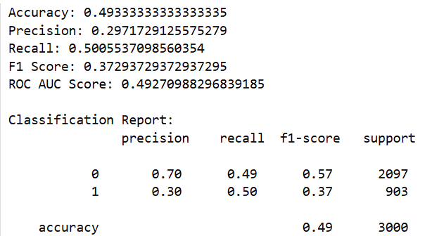
Model Training
Model – 1:
Logistic Regression: Classification Report:
The model's accuracy is very low, which means it is
not correctly predicting both the classes and is
struggling to generalize well.
Precision for class 1 (risky) is just 30%, meaning that
out of all the people predicted as risky, only 30% are
actually at risk — the rest are false alarms.
Recall for class 1 is around 50%, so the model is
missing half of the actual risky cases, which is a serious concern in medical predictions.
The main reason behind this low performance could be class imbalance. Techniques like SMOTE can help balance the classes and potentially improve the results.

Slide 16
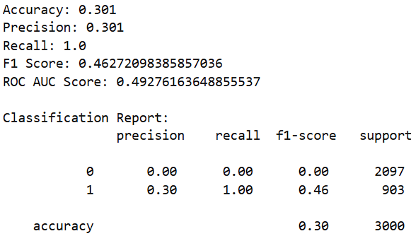
Model Training
Model – 1:
Logistic Regression - Custom Thresholding Insights (0.3):
Before applying SMOTE, I tried improving results using
custom thresholding.
The default threshold is 0.5, but I changed it to 0.3 so
the model pays more attention to the less populated
"risky" class.
With this change, the model started predicting almost
everything as risky (class 1). When tried with 0.6, it
predicted mostly class 0.
This shows that the model is highly sensitive to threshold changes and is biased toward one class due to imbalance.

Slide 17
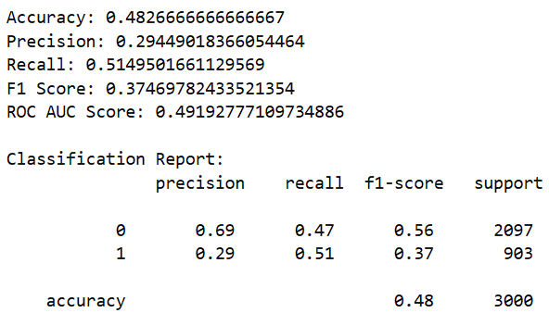
Model Training
Model – 1:
Logistic Regression - After Applying SMOTE Classification Report
After applying SMOTE, the recall for class 1 (risky)
improved slightly, meaning the model is now catching
more actual risky cases.
However, precision is still low, which means it’s also
predicting many false positives as risky.
The overall accuracy is still low, showing the model
struggles to correctly classify both classes.
SMOTE helped a bit with balance, but Logistic Regression still isn't handling the complexity of the data well.

Slide 18
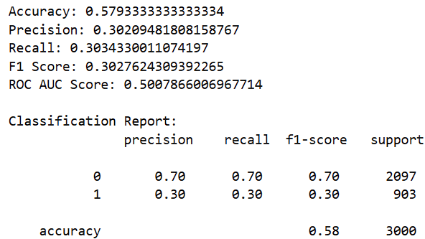
Model Training
Model – 2:
Decision Tree Classifier Classification Report
The model shows balanced precision and recall for
both classes, with around 70% for class 0 and 30%
for class 1.
It is performing consistently, but not effectively
enough for “risky” class (class 1).
The accuracy is slightly better than Logistic Regression,
but the model still struggles to clearly separate risky and
non-risky cases.
Overall, the model captures both classes reasonably, but to improve its performance, we proceeded with Decision Tree along with Grid Search Cross Validation for better tuning.

Slide 19
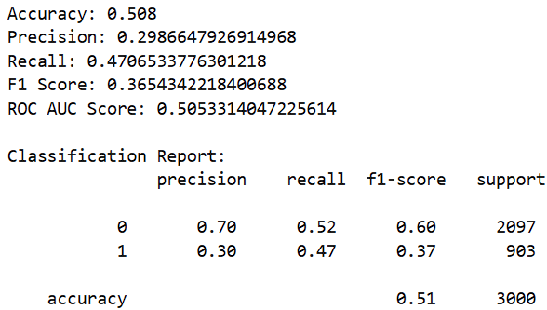
Model Training
Model – 2:
Decision Tree Classifier – Grid Search CV Classification Report
Applied Grid Search Cross Validation to tune the
Decision Tree model using different combinations of
hyperparameters.
The best parameters selected were: max_depth=15,
min_samples_split=2, and min_samples_leaf=1.
The model showed slight improvement in recall for the
risky class, but still struggled with overall accuracy and
precision.
Although hyperparameter tuning helped balance class predictions a bit, the model still needs further improvement through advanced techniques

Slide 20
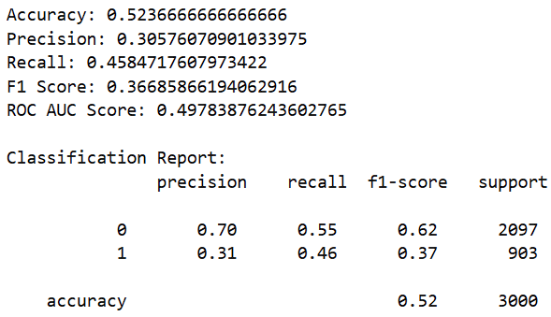
Model Training
Model – 3
Random Forest Classifier – Using Grid Search CV Classification Report
Grid Search CV was used to find the best
hyperparameters for the Random Forest model.
The optimal parameters were: n_estimators = 100,
max_depth = 13, min_samples_split = 2, and
min_samples_leaf = 1.
The model performed slightly better in recall and
overall balance compared to previous models.
While improvements are visible, but the model still
struggles with precision and needs further enhancements.

Slide 21
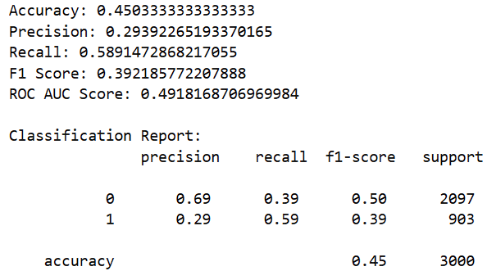
Model Training
Model – 3
Random Forest Classifier – After Applying SMOTE Classification Report
Compared to the Random Forest with Grid Search CV,
applying SMOTE improved the recall for the risky class (1),
but overall accuracy and precision dropped.
The model is now capturing more of the true positive
cases in the minority class, which is reflected in the
higher recall (≈59%).
However, this comes at the cost of a higher number of
false positives, leading to a lower precision.
SMOTE helped in handling the class imbalance, but not up to the mark.

Slide 22
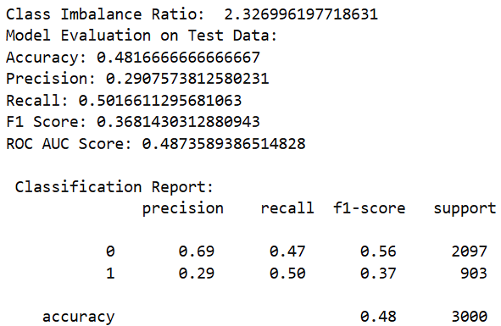
Model Training
Model – 4
XG Boost Classifier Classification Report
Trained an XGBoost Classifier by tuning
hyperparameters using Grid Search CV for better
model performance.
The model used class imbalance handling with
scale_pos_weight to give more focus to the minority
class.
Achieved a recall of 50% for the risky class, which
means the model is identifying half of the actual
positive cases.
Despite tuning, the overall performance remains moderate, indicating that class imbalance is still affecting
model results.

Slide 23
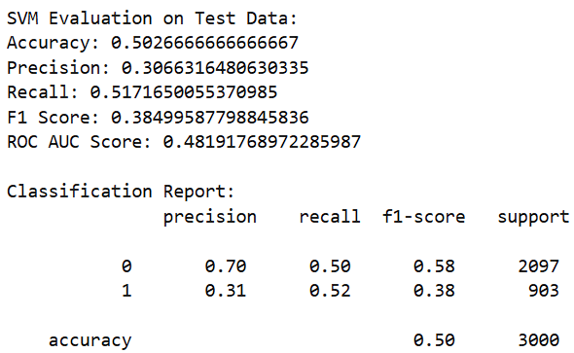
Model Training
Model – 5
Support Vector Machine Classification Report
The Support Vector Machine model achieved an
accuracy of 50%, which indicates poor overall
generalization.
It captured 51% of class 1 (risky) cases (recall), which
is better than random guessing.
However, precision for class 1 is low (31%), meaning
many false positives were predicted.
Even after this, the model still struggles, same trend
as before, the class imbalance continues.

Slide 24
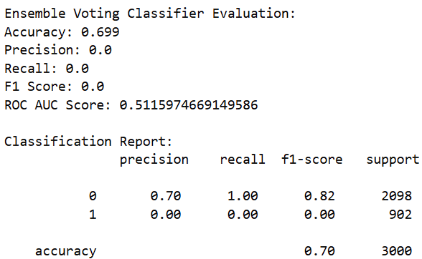
Model Training
Model – 6
Ensemble Voting Classifier Classification Report
Parallel Ensemble Approach: All five models
(Random Forest, Gradient Boosting, AdaBoost,
Logistic Regression, and SVC) were trained
independently and combined using soft voting.
High Accuracy, Poor Recall: While the model achieved
70.3% accuracy, it captured very few positive (risky)
cases, with a recall of just ~1.2%.
Class Imbalance Effect: Despite ensembling, the
model still heavily favors the majority class, reflecting
the persistent impact of class imbalance.

Slide 25
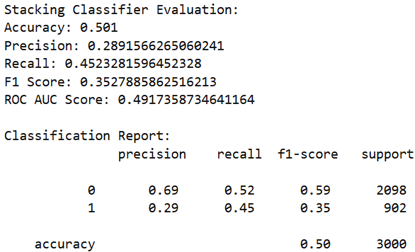
Model Training
Model – 6
Ensemble Stacking Classifier Classification Report
Stacking Classifier combines multiple base learners
(RF, GB, AdaBoost, Logistic Regression, SVC) with a
Logistic Regression as the meta-model.
All base models are trained independently, and their
predictions are used as inputs for the final estimator.
Achieved 50.1% accuracy and an F1 Score of 0.35,
showing limited improvement despite using advanced
ensembling.
Even with robust cross-validation (cv=5) and
class-balanced meta-model, the performance was impacted by severe class imbalance.

Slide 26
Conclusion
This project aimed to predict heart attack risk using machine learning models on a highly imbalanced healthcare dataset.
Despite exploring a wide range of models—including logistic regression, decision trees, ensemble methods, and advanced stacking—the class imbalance significantly impacted performance, especially for the minority class. While some models showed promise in recall, overall precision and F1 scores remained moderate.
This highlights the complexity of medical predictions and the need for more balanced data and advanced techniques. The project provided deep insights into model behavior under real-world data challenges.

Slide 27
Challenges
The major challenge I’ve faced throughout this project was severe class imbalance in the dataset. Despite experimenting with multiple techniques like SMOTE, class weighting, and advanced ensemble methods, the results remained same.
Handling this imbalance effectively is still an open task, and I’m actively exploring better strategies to improve model performance.

Slide 28
Experience
Working on this project was an enriching and eye-opening experience. I not only deepened my technical skills—such as advanced model tuning, evaluation, and ensemble learning—but also gained a better understanding of the importance of problem framing, patience, and analytical thinking. This project truly tested my ability to manage setbacks and adapt strategies on the go.
Unlike my previous four machine learning projects, this one stood out due to its complexity and unpredictability. It wasn’t just about applying models but understanding why they struggled. This made it feel more like a real-world data science problem, where perfect results aren't guaranteed, and finding insights is just as important as achieving high accuracy.

Slide 29


Slide 30

THANK YOU

